Slide 1
Welcome to BOKU
Priv.-Doz. DI Dr. Michael Tritthart
University of Natural Resources and Life Sciences BOKU, Vienna
Meeting Vienna / 8th May 2019
This project has been funded with support from the European Commission. This publication reflects the views only of the author, and the Commission cannot be held responsible for any use which may be made of the information contained therein.

Slide 2
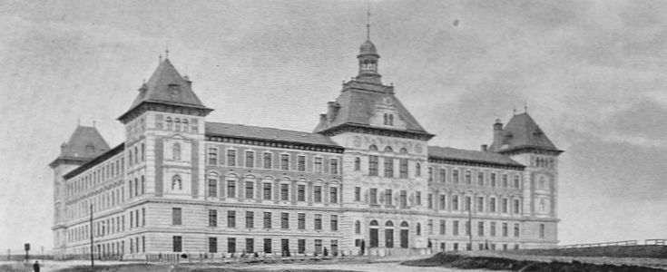
BOKU – University of Natural Resources and Life Sciences, Vienna
Name of the university: „Bodenkultur“
➔ relates to Agriculture
Founded in 1872

Slide 3
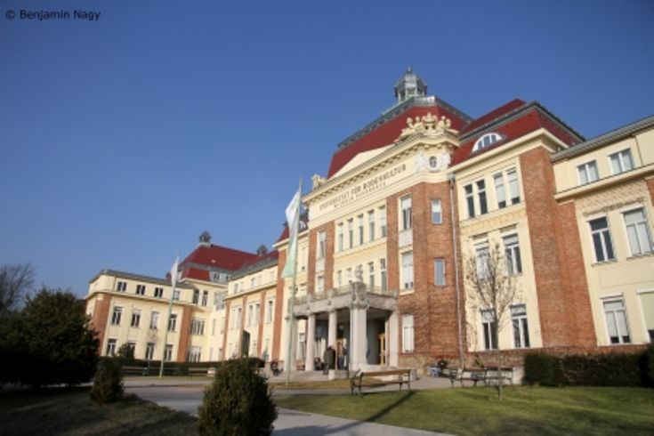
BOKU – University of Natural Resources and Life Sciences, Vienna
Founded with three study branches:
  Agriculture
  Forestry
  Environmental Engineering and Water Management
Further fields of study and research added after 1945, e.g.
  Food Science and Biotechnology
  Landscape Planning
  Environmental Studies

Slide 4
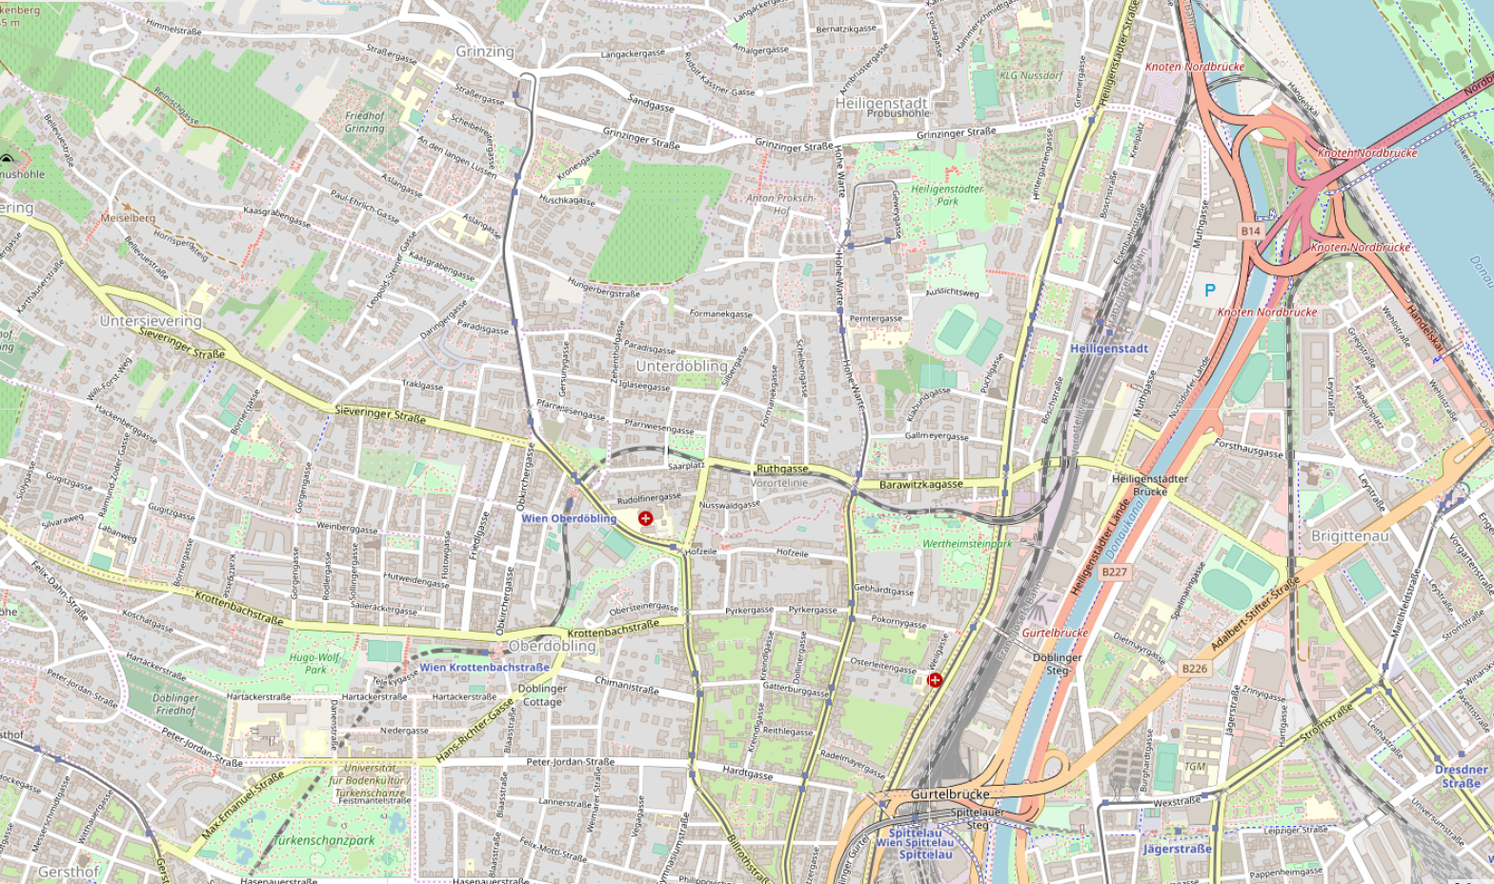
Campus locations

Slide 5
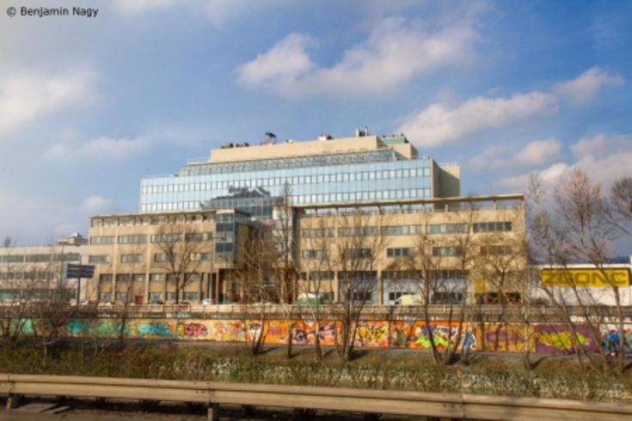
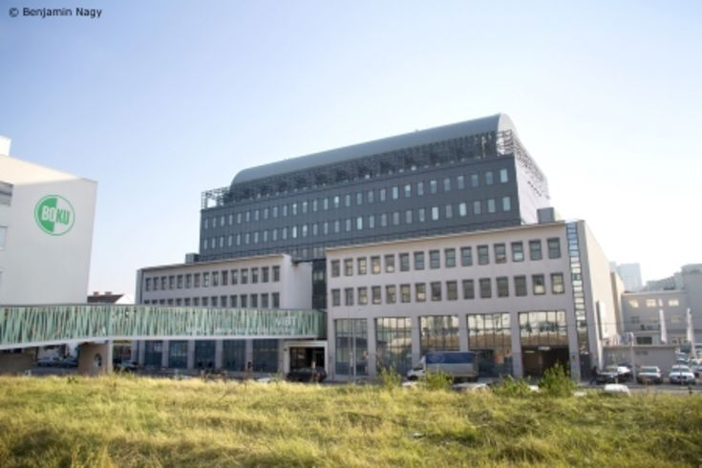
Muthgasse buildings
In Muthgasse: Biotechnology and life sciences campus
(VIBT = Vienna Institute of Bio-Technology)
All water-related institutes

Slide 6
BOKU - facts and figures
Students
… from Austria | 9.728
… from the EU | 1.946
… from third countries | 606
Overall | 12.280
Staff
Scientific staff | 1.004
Non-scientific staff | 580
Overall staff | 1.584
Study programs
Bachelor | 8
Master | 26
PhD | 4
Overall | 38

Slide 7

Mission statement today
„It is BOKU´s core competence to
research and impart knowledge of
sustainably using natural resources and thus providing options to safeguard natural resources. Thereby the „University of Life“ offers answers to issues that affect the general public and that are highly relevant for each and everyone of us.“

Slide 8

Organisation
University (BOKU)
  15 Departments
  (Department of Water, Atmosphere and Environment – WAU)
    67 Institutes
    (Institute of Hydraulic Engineering and River Research)

Slide 9
Study programs
Programs with department responsibility
Bachelor Level
Environmental Engineering (Kulturtechnik und Wasserwirtschaft) | 48%
Master Level
Environmental Engineering (Kulturtechnik und Wasserwirtschaft) | 44%
Water Management and Environmental Engineering (WMEE) | 57%
Applied Limnology (MAL) | 100%
Natural Resources Management and Ecological Engineering (NARMEE) | 38%
Environmental Sciences – Soil, Water and Biodiversity (ENVEURO) | 35%
Alpine Natural Dangers / Watershed Regulation | 11%

Slide 10
Agenda Day 1

Slide 11
Agenda Day 2

Slide 12
Agenda Day 3

Slide 13

Contact information
University of Natural Resources and Life Sciences Vienna (BOKU)
Department of Water, Atmosphere and Environment (WAU)
Institute of Hydraulic Engineering and River Research (IWA)
Find more about us in
http://www.wau.boku.ac.at/en/
Michael Tritthart
Priv.-Doz. Dipl.-Ing. Dr.techn.
E-mail: michael.tritthart@boku.ac.at
Kurt Glock
Dipl.-Ing.
E-mail: kurt.glock@boku.ac.at

